Slide 1
COMPUTER PROGRAMMING-I
100

Slide 2
What is a programming language?
Programming Language is
  A tool for instructing machines.
  A means of communicating between programmers.
  A means of controlling computerized devices.
  A notation for algorithms.

Slide 3
Programming Domains
Scientific applications
Business applications
Artificial intelligence
Systems programming
Scripting languages
Special purpose languages

Slide 4
Machine Language
Machine language is the lowest-level programming language.
Machine languages are the only languages understood by computers.
A computer programming language consisting of binary or hexadecimal instructions which a computer can respond to directly.

Slide 5

Why Humans Don't Use Machine Language

Slide 6
Machine languages are almost impossible for humans to use because they consist entirely of numbers.
Programmers, therefore, use either a high-level programming language or an assembly language.
An assembly language contains the same instructions as a machine language, but the instructions and variables have names instead of being just numbers.

Slide 7
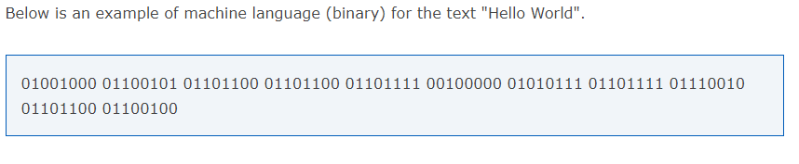
Example of Machine language:

Slide 8
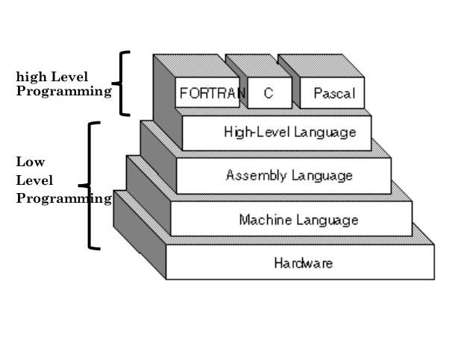
Types of Programming Language

Slide 9
Assembly Language
A low-level symbolic code converted by an assembler.
Assembly language is converted into executable machine code by a utility program referred to as an assembler like NASM, MASM, etc.
A processor understands only machine language instructions, which are strings of 1's and 0's.
However, machine language is too obscure and complex for using in software development. So, the low-level assembly language is designed for a specific family of processors that represents various instructions in symbolic code and a more understandable form.

Slide 10
Advantages of Assembly Language
1.Having an understanding of assembly language makes one aware of −
How programs interface with OS, processor, and BIOS;
How data is represented in memory and other external devices;
How the processor accesses and executes instruction;
How instructions access and process data;
How a program accesses external devices.
2. The symbolic programming of Assembly Language is easier to understand and saves a lot of time and effort of the programmer.
3.It is easier to correct errors and modify program instructions.
4.Assembly Language has the same efficiency of execution as the machine level language. Because this is one-to-one translator between assembly language program and its corresponding machine language program.

Slide 11
Disadvantages of assembly language
Mnemonics in assembly language are in abbreviated form and in large number, so they are hard to remember.
Program written in assembly language are machine dependent, so are incompatible for different type of machines.
A program written in assembly language is less efficient to same program in machine language.
Mnemonics can be different for different machines according to manufacturers so assembly language suffers from the defect of non-standardization
Assembly is called a low-level programming language because there is (nearly) a one-to-one relationship between what it tells the computer to do, and what the computer does. In general, one line of an assembly program contains a maximum of one instruction for the computer.

Slide 12
An Assembly program to read in two decimal inputs and print out their sum, in decimal
DATA SEGMENT
NUM1 DB ?
NUM2 DB ?
RESULT DB ?
MSG1 DB 10,13,"ENTER FIRST NUMBER TO ADD : $“
MSG2 DB 10,13,"ENTER SECOND NUMBER TO ADD : $“
MSG3 DB 10,13,"RESULT OF ADDITION IS : $"
ENDS
In Assembly programming, the variable are all defined by bytes only.
DB – Define Byte (Size – 1 Byte)
DW – Define Word (Size – 2 Byte)
DD – Define Double word (Size - 4 Bytes)
DQ – Define Quad word (Size – 8 Bytes)
DT – Define Ten Bytes (Size – 10 Bytes)

Slide 13
High Level Language
A high-level language is a programming language such as C, FORTRAN, or Pascal that enables a programmer to write programs that are more or less independent of a particular type of computer.
Such languages are considered high-level because they are closer to human languages.

Slide 14
Advantages of high-level languages
Better portability (program runs on many CPUs)
Richer data types and memory management
Natural structures for expressing flow of control
Much better support for software maintenance
Much better support for software reuse

Slide 15
Translation Process of HLL
Compiler: Translates an entire high-level language program into machine code before it is executed. Programming language like C, C++ use compilers.
Interpreter: Simulates a high-level language program, translating commands to machine code along the way, only as needed. Programming language like Python, Ruby use interpreters.

Slide 16
Difference between Compiler and Interpreter
Interpreter | Compiler
Translates program one statement at a time. | Scans the entire program and translates it as a whole into machine code.
It takes less amount of time to analyze the source code but the overall execution time is slower. | It takes large amount of time to analyze the source code but the overall execution time is comparatively faster.
No intermediate object code is generated, hence are memory efficient. | Generates intermediate object code which further requires linking, hence requires more memory.
Continues translating the program until the first error is met, in which case it stops. Hence debugging is easy. | It generates the error message only after scanning the whole program. Hence debugging is comparatively hard.
Programming language like Python, Ruby use interpreters. | Programming language like C, C++ use compilers.

Slide 17
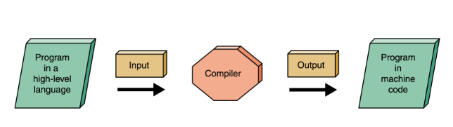
Compiler

Slide 18
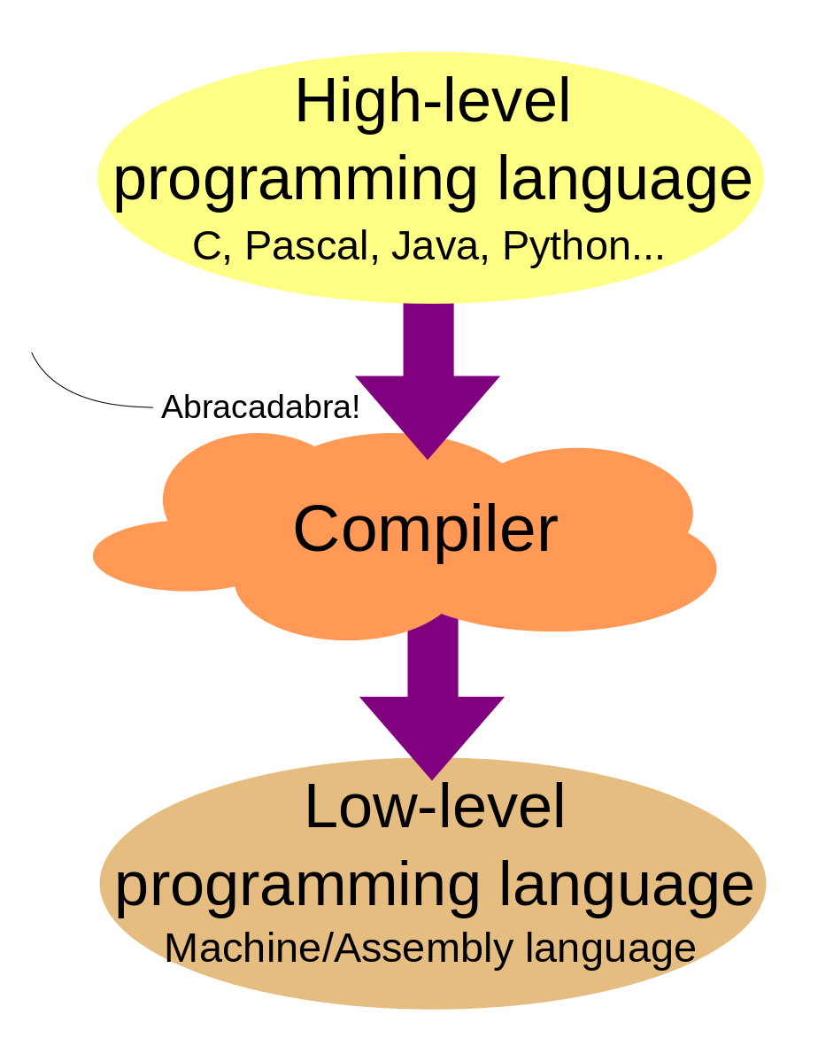

Slide 19
Features of C language
It is a robust language with rich set of built-in functions and operators that can be used to write any complex program.
The C compiler combines the capabilities of an assembly language with features of a high-level language.
Programs Written in C are efficient and fast. This is due to its variety of data type and powerful operators.
C is highly portable this means that programs once written can be run on another machines with little or no modification.
Another important feature of C program, is its ability to extend itself.

Slide 20
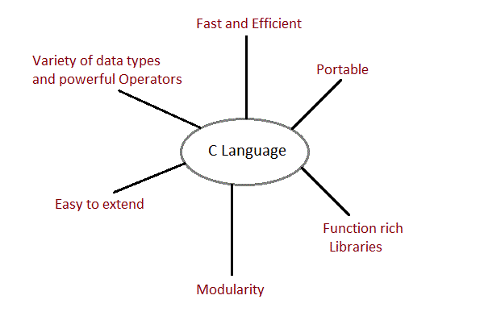
Features of C language

Slide 21
C - Program Structure
A C program basically consists of the following parts −
Preprocessor Commands
Functions
Variables
Statements & Expressions
Comments

Slide 22
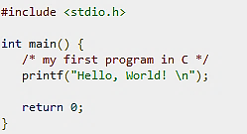
Sample Program

Slide 23
Let us take a look at the various parts of the above program −
The first line of the program #include <stdio.h> is a preprocessor command, which tells a C compiler to include stdio.h file before going to actual compilation.
The next line int main() is the main function where the program execution begins.
The next line /*...*/ will be ignored by the compiler and it has been put to add additional comments in the program. So such lines are called comments in the program.
The next line printf(...) is another function available in C which causes the message "Hello, World!" to be displayed on the screen.
The next line return 0; terminates the main() function and returns the value 0.

Slide 24
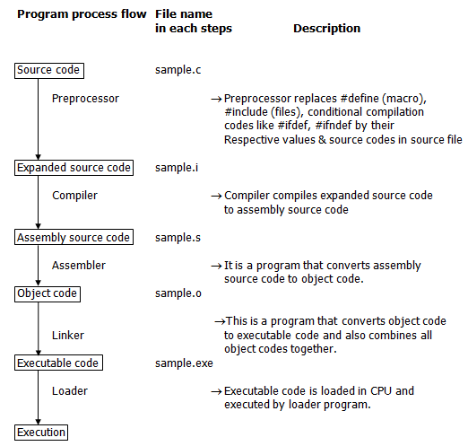
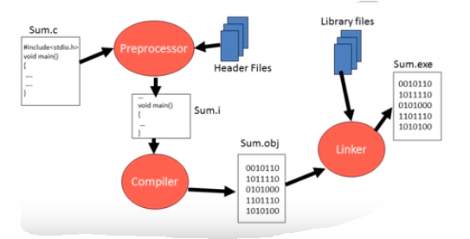


Slide 25
Character set of C
It denotes any alphabet, digit or special symbol used to represent information.
1. Source character set
a. Alphabets
b. Digits
c. Special Characters
d. White Spaces
2. Execution character set
a. Escape Sequence

Slide 26
Source character set
ALPHABETS
Uppercase letters ---------- A-Z
Lowercase letters ---------- a-z
DIGITS -------------------------------- 0, 1, 2, 3, 4, 5, 6, 7, 8, 9

Slide 27
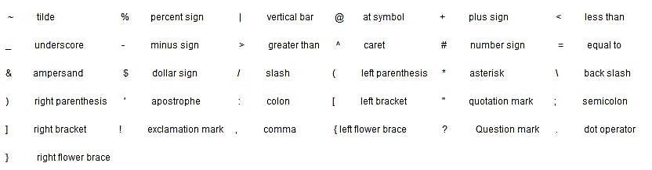
Special Characters

Slide 28


WHITE SPACE CHARACTERS

Slide 29
Execution Character Set
Certain ASCII characters are unprintable, which means they are not displayed on the screen or printer. Those characters perform other functions aside from displaying text. Examples are backspacing, moving to a newline, or ringing a bell.
These are employed at the time of execution of the program. Execution characters set are always represented by a backslash (\) followed by a character. Note that each one of character constants represents one character, although they consist of two characters. These characters combinations are called as escape sequence

Slide 30
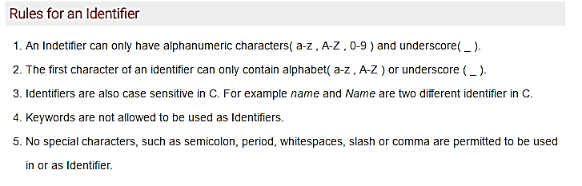
Identifiers
In C language identifiers are the names given to variables, constants, functions and user-define data.
These identifier are defined against a set of rules.

Slide 31
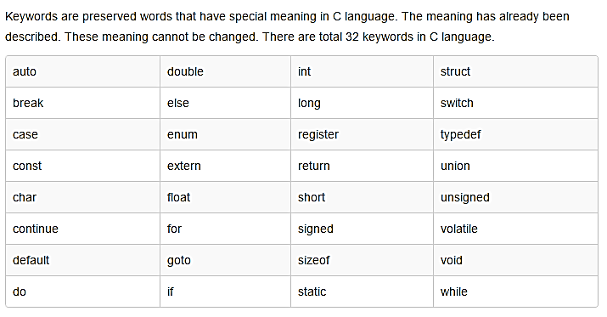
Keywords

Slide 32
C - Variables
A variable is nothing but a name given to a storage area that our programs can manipulate.
Each variable in C has a specific type, which determines the size and layout of the variable's memory;
The name of a variable can be composed of letters, digits, and the underscore character. It must begin with either a letter or an underscore. Upper and lowercase letters are distinct because C is case-sensitive.

Slide 33
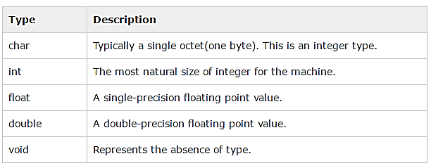
Types of Variable

Slide 34
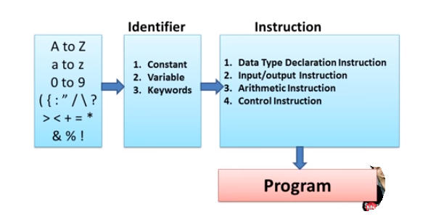

Slide 35
Constant
Constants refer to fixed values that the program may not alter during its execution.
These fixed values are also called literals.
Constants can be of any of the basic data types like an integer constant, a floating/Real constant, a Single character constant, or a string Constant.
Constants are treated just like regular variables except that their values cannot be modified after their definition.

Slide 36
Constant
CONSTANT
NUMERIC
CHARACTER
Integer
Real
Single Character
String Constant

Slide 37
Integer Literals
Sequence of No’s from 0 – 9 without decimal point.
It requires min two bytes and max 4 bytes.
It can be +ve or -ve or may be zero.

Slide 38
Real/Floating Constant
A floating-point literal has an integer part, a decimal point, a fractional part, and an exponent part.
You can represent floating point literals either in decimal form or exponential form.
Examples:
3.14159 /* Legal */
314159E-5L /* Legal */
510E /* Illegal: incomplete exponent */
210f /* Illegal: no decimal or exponent */
.e55 /* Illegal: missing integer or fraction */

Slide 39
Single Character Constant
Character literals are enclosed in single quotes, e.g., 'x' can be stored in a simple variable of char type.
A character literal can be a plain character (e.g., 'x'), an escape sequence (e.g., '\t') or white space enclosed in single quote.
Character constant have integer values known as ASCII values.

Slide 40
String Constant
String literals or constants are enclosed in double quotes "".
String may be a combination of all kinds of symbols.
Example
“Hello”
“India”
“444”

Slide 41
Defining Constants
There are two simple ways in C to define constants −
  Using #define preprocessor.
  Using const keyword.
#define identifier value
Const datatype identifier = value

Slide 42
C Input output function
I/O FUNCTIONS
FORMATTED
UNFORMATTED
INPUT
getch()
getche()
getchar()
gets()
getc()
OUTPUT
putch()
putchar()
puts()
Scanf -- Input
Printf -- Output

Slide 43
C Formatted IO Functions
Input data or output results are formatted as per requirement. Formatted function improves the readability of the input and output. Formatted functions can be used to read and write data of all data type(char, int, float, double). Formatted input and output functions require format specifiers(%c, %d, %f, %lf) to identify the type of data.
C Unformatted Functions
Unformatted input and output functions are only work with character data type. Unformatted input and output functions do not require any format specifiers. Because they only work with character data type.

Slide 44
Example:
#include <stdio.h> //header file section
int main()
{
int a, b, c;
printf("Enter the value of a = ");
scanf("%d",&a) ; //read value a through keyboard
printf("\nEnter the value of b = ");
scanf("%d",&b); //read value b through keyboard
c = a + b;
printf("\na + b = %d ",c); //Print the sum of two value a and b return 0;
}

Slide 45
getchar() & putchar() functions
The getchar() function reads a character from the terminal and returns it as an integer. This function reads only single character at a time.
The putchar() function prints the character passed to it on the screen and returns the same character. This function puts only single character at a time.

Slide 46
Example
#include <stdio.h>
#include <conio.h>
void main( )
{
char c;
printf("Enter a character");
c=getchar();
putchar(c);
getch();
}
The getchar() function reads character type data form the input. The getchar() function reads one character at a time till the user presses the enter key.

Slide 47
gets() & puts() functions
The gets() function reads a line from stdin (keyboard) into the buffer pointed to by s until enter key is pressed.
The puts() function writes the string s and a trailing newline to stdout.

Slide 48
Example
#include<stdio.h>
#include<conio.h>
void main()
{
char str[100];
printf("Enter a string");
gets( str );
puts( str );
getch();
}

Slide 49
getch() & putch() functions
The getch() function reads any alphanumeric characters from stdin (keyboard). The entered character is not displayed by getch() function.
The putch() function writes the alphanumeric characters taken from stdin (keyboard).

Slide 50
Example
#include<stdio.h>
#include<conio.h>
void main()
{
char ch;
printf("Enter a character");
ch=getch( );
putch( ch );
getch();
}
The getch() function reads the alphanumeric character input from the user. But, that the entered character will not be displayed.

Slide 51
getche function
The getche() function reads any alphanumeric characters from stdin (keyboard). The entered character is not displayed by getche() function.
#include <stdio.h> //header file section
#include <conio.h>
int main()
{
printf("\nHello, press any alphanumeric character or symbol to exit \n ");
getche();
return 0;
}
getche() function reads the alphanumeric character from the user input. Here, character you entered will be echoed to the user until he/she presses any key

Slide 52
Data types in C Language
Data types specify how we enter data into our programs and what type of data we enter.
C language has some predefined set of data types to handle various kinds of data that we use in our program.
These datatypes have different storage capacities.
C language supports 2 different type of data types:
  Primary Data Type: These are fundamental data types in C namely integer(int), floating(float), charater(char) and void.
  Derrived Data Type: Derived data types are like arrays, functions, stuctures and pointers.

Slide 53
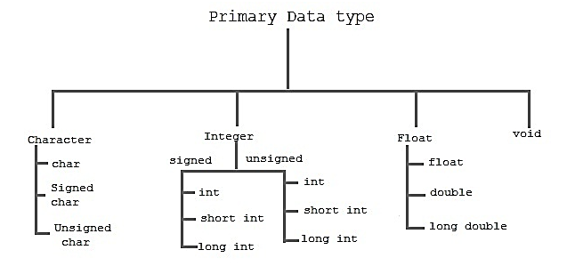

Slide 54
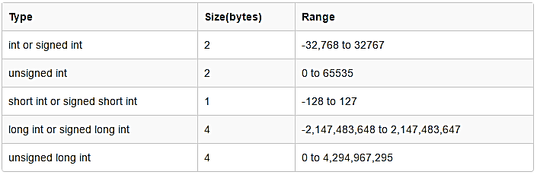
Integer type

Slide 55
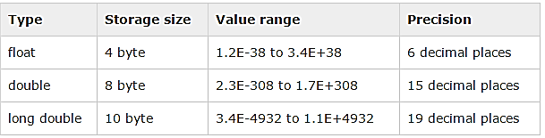
Floating type

Slide 56
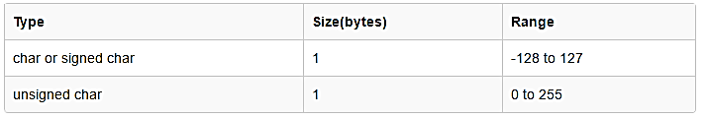
Character Type

Slide 57
Operators in C Language
C language supports a rich set of built-in operators.
An operator is a symbol that tells the compiler to perform certain mathematical or logical manipulations.
Operators are used in program to manipulate data and variables.

Slide 58
Operators in C Language
C operators can be classified into following types,
  Arithmetic operators
  Relation operators
  Logical operators
  Bitwise operators
  Assignment operators
  Conditional operators
  Special operators

Slide 59
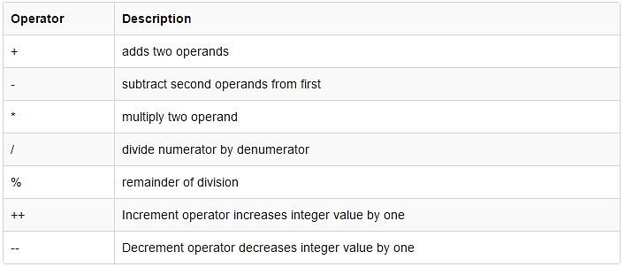
Arithmetic operators
C supports all the basic arithmetic operators.

Slide 60
#include <stdio.h>
int main()
{
int a = 9,b = 4, c;
c = a+b;
printf("a+b = %d \n",c);
c = a-b;
printf("a-b = %d \n",c);
c = a*b;
printf("a*b = %d \n",c);
c = a/b;
printf("a/b = %d \n",c);
c = a%b;
printf("Remainder when a divided by b = %d \n",c);
return 0;
}

Slide 61
#include <stdio.h>
int main()
{
int a = 10, b = 100;
float c = 10.5, d = 100.5;
printf("++a = %d \n", ++a);
printf("--b = %d \n", --b);
printf("++c = %f \n", ++c);
printf("--d = %f \n", --d);
return 0;
}

Slide 62
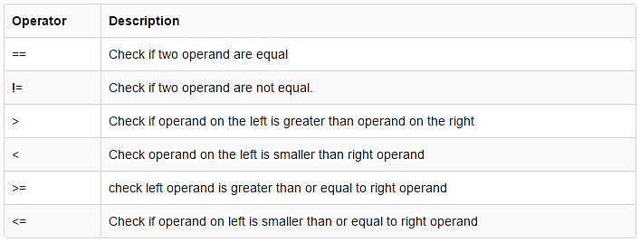
Relation operators

Slide 63
#include <stdio.h>
int main()
{
int a = 5, b = 5, c = 10;
printf("%d == %d is %d \n", a, b, a == b);
printf("%d == %d is %d \n", a, c, a == c);
printf("%d > %d is %d \n", a, b, a > b);
printf("%d > %d is %d \n", a, c, a > c);
printf("%d < %d is %d \n", a, b, a < b);
printf("%d < %d is %d \n", a, c, a < c);
printf("%d != %d is %d \n", a, b, a != b);
printf("%d != %d is %d \n", a, c, a != c);
printf("%d >= %d is %d \n", a, b, a >= b);
printf("%d >= %d is %d \n", a, c, a >= c);
printf("%d <= %d is %d \n", a, b, a <= b);
printf("%d <= %d is %d \n", a, c, a <= c);
return 0;
}

Slide 64
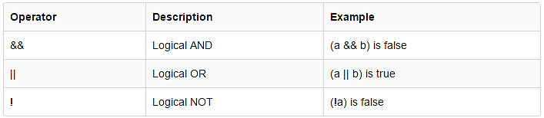
Logical operators

Slide 65
#include <stdio.h>
int main()
{
int a = 5, b = 5, c = 10, result;
result = (a == b) && (c > b);
printf("(a == b) && (c > b) is %d \n", result);
result = (a == b) && (c < b);
printf("(a == b) && (c < b) is %d \n", result);
result = (a == b) || (c < b);
printf("(a == b) || (c < b) is %d \n", result);
result = (a != b) || (c < b);
printf("(a != b) || (c < b) is %d \n", result);
result = !(a != b);
printf("!(a == b) is %d \n", result);
result = !(a == b);
printf("!(a == b) is %d \n", result);
return 0;
}

Slide 66
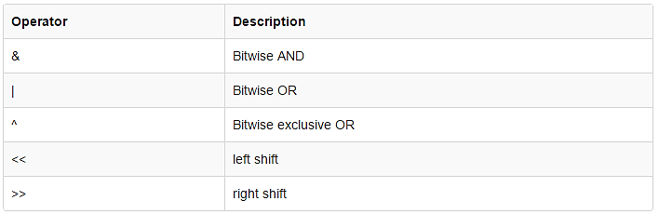
Bitwise operators
Bitwise operators perform manipulations of data at bit level.
These operators also perform shifting of bits from right to left. Bitwise operators are not applied to float or double.

Slide 67
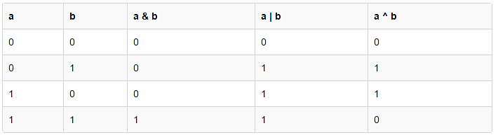
Bitwise operators

Slide 68
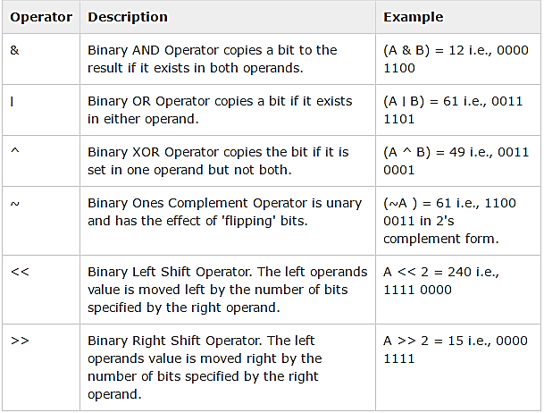
Assume variable 'A' holds 60 and variable 'B' holds 13

Slide 69
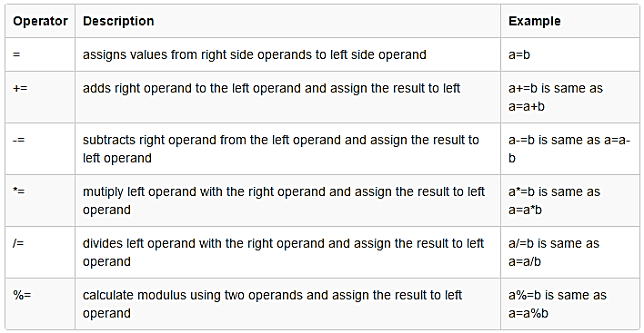
Assignment Operator

Slide 70
Conditional operator
It is also known as ternary operator and used to evaluate conditional expression.
If epr1 Condition is true ? Then value expr2 : Otherwise value expr3
printf("%d", a>b? a : b);
epr1 ? expr2 : expr3

Slide 71
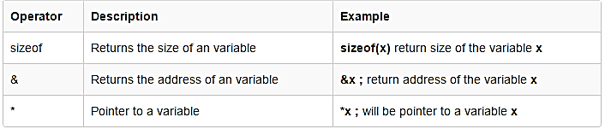
Special operator

Slide 72
C Programming Expression
In programming, an expression is any legal combination of symbols that represents a value.
C Programming Provides its own rules of Expression, whether it is legal expression or illegal expression. For example, in the C language x+5 is a legal expression.
Every expression consists of at least one operand and can have one or more operators.
Operands are values and Operators are symbols that represent particular actions.

Slide 73
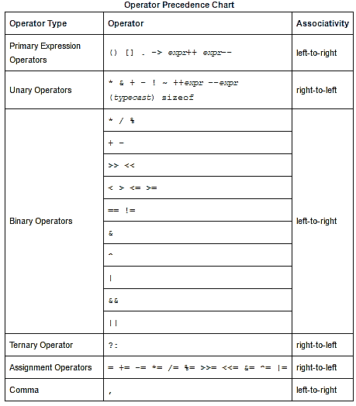

Slide 74
Type Conversion
Type casting is a way to convert a variable from one data type to another data type. For example, if you want to store a 'long' value into a simple integer then you can type cast 'long' to 'int'. You can convert the values from one type to another explicitly using the cast operator as follows −
(type_name) expression

Slide 75
Example
main()
{
int sum = 17, count = 5;
double mean;
mean = (double) sum / count;
printf("Value of mean : %f\n", mean );
}

Slide 76
Implicit Type Conversion
When the type conversion is performed automatically by the compiler without programmers intervention, such type of conversion is known as implicit type conversion or type promotion. Also known as ‘automatic type conversion’.
The compiler converts all operands into the data type of the largest operand.

Slide 77
Explicit Type Conversion
The type conversion performed by the programmer by posing the data type of the expression of specific type is known as explicit type conversion.
The explicit type conversion is also known as type casting.

Slide 78
Example:
#include<stdio.h>
void main()
{
int a=5,sum;
double b=8;
b=a+b;//implicit conversion
clrscr();
printf("%f",b);
sum=(int)b+1; //explicit conversion
printf("\n\n%d",sum);
getch();
}

